Slide 1
Caveat Emptor:
A Comparative Study of Secure Device Pairing Methods
Arun Kumar[1], Nitesh Saxena[1]
Gene Tsudik[2], Ersin Uzun[2]
2009 IEEE International Conference on Pervasive Computing and Communications
Notes:
[1]Computer Science and Engineering Department 紐約大學
[2]Computer Science Department 加州大學爾灣分校
這個conference在CS conference上的ranking是屬於A+的。

Slide 2
Outline
Introduction
Background
Study Preliminaries
Usability testing detail
Interpreting results
Conclusions and future work

Slide 3
Introduction
Secure Device Pairing
Motivation
Contribution
Notes:
雖然本篇論文文的技術含量不如傳統的安全性和應用密碼學研究，但因為論文中是從另一個安全技術上重要的切入點-可用性切入，使得這篇論文可以投上頂級的conference

Slide 4
Introduction
Secure Device Pairing:
  The process of bootstrapping a secure channel between two previously unassociated devices over a human-imperceptible communication channel.
There are many current everyday usage scenarios where two devices need to “work together”. e.g. Bluetooth headset and a cellphone.
The focus of our study is on most common pairing scenarios where a single user controls both the devices.

Slide 5
Motivation
Prior methods have been developed by security researchers who are experts in security and not usability.
Usability of current device pairing methods remains very unclear.
Since this topic has matured enough, it is also the right time for experimental assessment of usability factors.

Slide 6
Contribution
We overview prominent device pairing methods, implement them using a common software platform and conduct the first comprehensive and comparative field study, focusing on both usability and security.
The study yields some interesting results which help us identify most appropriate method(s) for a given combination of devices.
Notes:
整合突出的配對方法，放到同一個裝置去測試跟實驗。
那些裝置適用於哪些方法。探討實用性跟安全性，比較方法
在初始配對的時候就被MitM

Slide 7
Background
Cryptographic Protocols
Device Pairing Methods

Slide 8
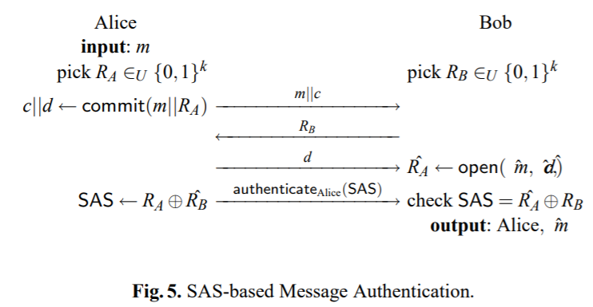
Cryptographic Protocols
SAS (Short Authenticated Strings) protocol
  Limits attack probability to 2-k for k-bit OOB channels, even when the adversary can delay/replay OOB messages.

Slide 9
OOB(Out-of-Band) Channel
Out of band
  Activity that occurs outside of a specific telecommunications frequency band.
  This phrase is used in different ways to talk about different kinds of multichannel messaging or multichannel signaling.
Notes:
控制是另外一套來做，人的介入

Slide 10
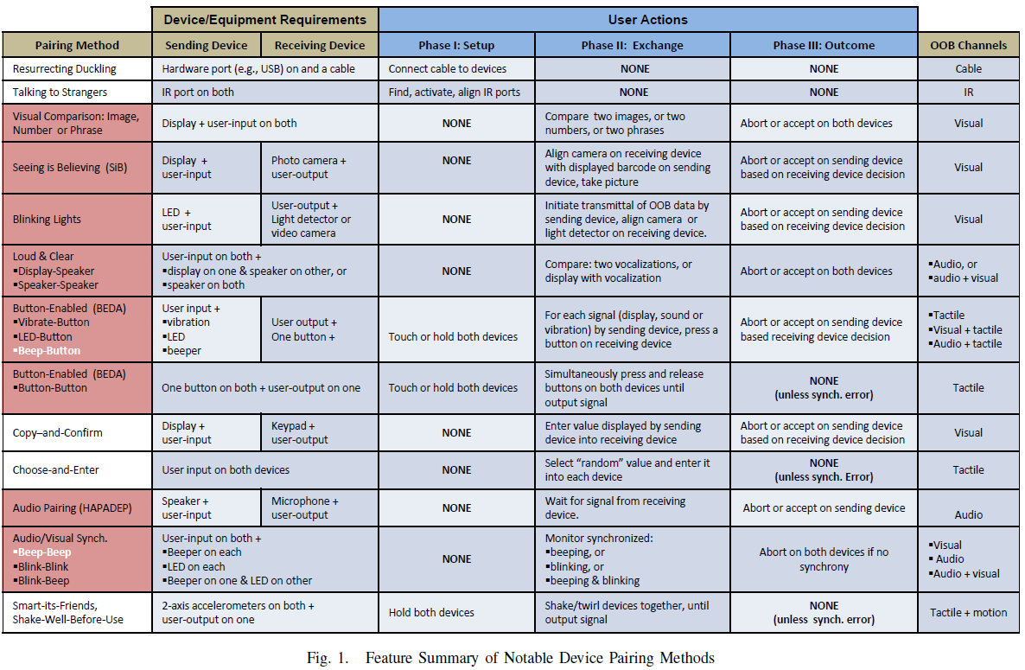
Device Pairing Methods
Notes:
配對媒介要有cable連接，確保channel secure
2. 需要具有紅外線功能的配對。protocol: 傳msg的時候會有隨機的string
3. 利用圖片或數字來確認
4. SiB透過bar code
5. LED閃爍的間隔來判斷是否為該裝置

Slide 11
Device Pairing Methods
Notes:
phase3: 是否完成配對
1. 透過按鈕來配對

Slide 12
Study Preliminaries
What methods to test?
What devices to use?
Implementation Details
Notes:
本節說明如何挑選測試方法和設備的選擇標準以及我們software platform的architecture。

Slide 13
What Methods To Test?
There are probably about 20 methods at first.
  Too many experiments will make the user fatigue and affect the experimental results
After cull the number of methods down to a more manageable number (13 methods), eliminating those that are obsolete, exotic or deprecated based on prior evaluations.

Slide 15
What Devices to Use?
We used two Nokia cellphones models: N73 and E61.
This was done on purpose in order to avoid devices with exotic or expensive features than those commonly available at present.
Another reason for choosing these devices is the plethora of common interfaces available on them.
  Audio channel require: speaker, beeper or vibration.
  Visual channel require: LED, screen or camera viewfinder.
  Tactile channel require: vibration, button or keypad.

Slide 16
Implementation Details
The fair comparison basis is formed by:
  (1) Keeping the same test devices.
    Nokia N73 or E61.
  (2) Employing consistent GUI design practices.
  (3) Unifying targeted security level for all methods.
    SAS string length constant at 15bits.
Minimizing any experimenter introduced, systematic and cognitive bias is also important.
  Randomize test order.
  Avoid close physical proximity.
  Avoid interaction between the participant and the experimenter.
  Automate timing and logging to minimize errors and biases.
Notes:
我們的目標是盡可能地將不同方法中的用戶交互隔離為所有測試中唯一的自變量。
把SAS strin設到同一個level

Slide 17
Implementation Details
To achieve a unified software platform, our implementation used the open-source comparative usability testing framework developed by Kostiainen, et al.
  It provides basic communication primitives between devices as well as automated logging and timing functionality.
We used JAVA-MIDP to implement all methods and created several test-cases for ”no-attack” and ”under-attack” scenarios.
Notes:
透過Java-MIDP來製造test-cases
Java-MIDP用於無線裝置上的java規格

Slide 18
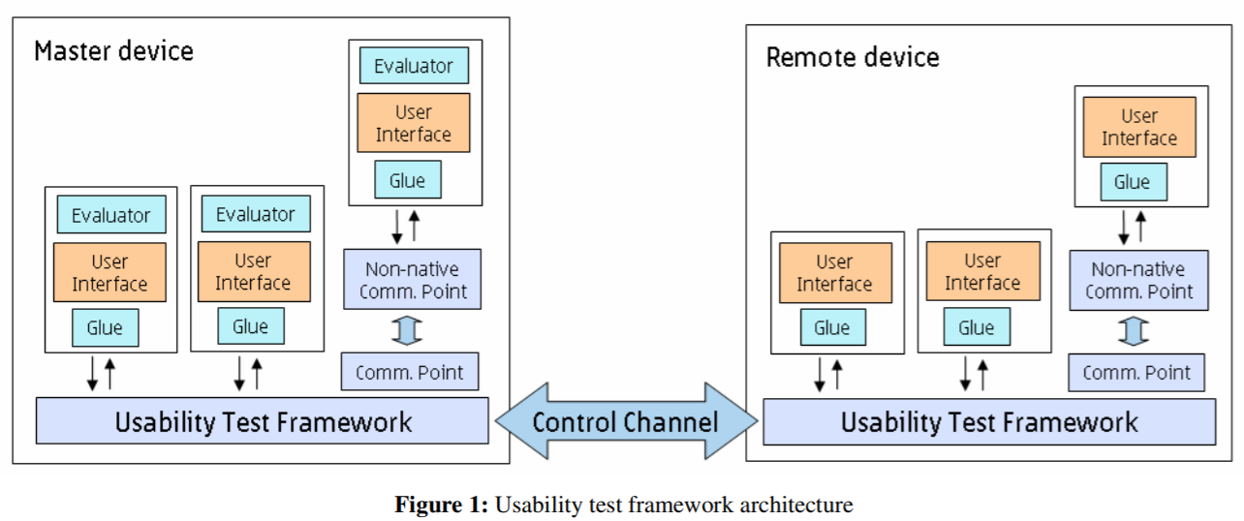
Comparative usability testing framework
Notes:
sender、reciever

Slide 19
Usability Testing Detail
Goal and Evaluation Metrics
Study Participants
Testing Process
Test Results

Slide 20
Usability Study – Goal and Evaluation Metrics
Goal: Evaluate and compare the pairing methods with respect to the following factors:
  Efficiency: time it takes to complete each method.
  Robustness: how often each method leads to false positives(rejection of a successful pairing instance) and false negatives (acceptance of a failed pairing instance).
  Usability: how each methods fares in term of user burden(i.e., ease-of-use perception) and personal preference.

Slide 21
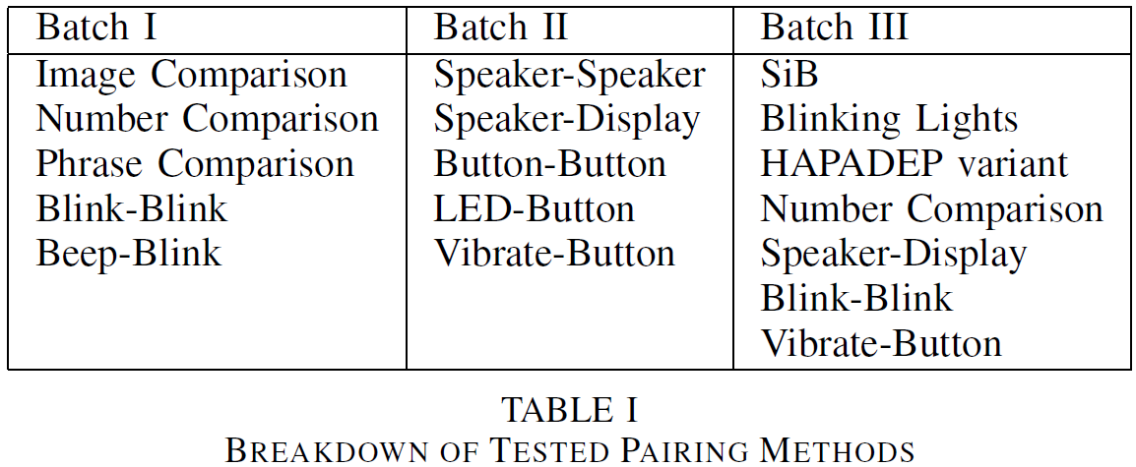
Usability Study - Issue
Sheer number of methods to be tested - 13, and nearly 50 test-cases.
To remedy the problem, we pursued the study in three batches.
Notes:
分組是依據time and tedium factor

Slide 22
Study Participants
# of participants: 20
Participants were mostly university students.
Every one must complete all three test batches.
If highly-motivated and technology-savvy young people do not react well to a given method, the same method will perform a lot worse with average users.

Slide 23
Testing Process
After giving a brief overview of our study goals, we asked the participants to fill out the background questionnaire in order to collect demographic information.
After completing the tasks in each batch of the tests, each user filled out a post-test questionnaire form, where they provided their feedback on various methods tested in that particular batch.
Finally, users were also given a few minutes of free discussion time, where they explained to the test administrator about their experience with the various methods they tested.
Notes:
2. To reduce the learning effect on test results, the tasks were always presented to the user in random order.

Slide 24
Test Results
We collected data in two ways:
  By timing and logging user interaction.
  Post-test questionnaires and free discussions.
Completion times, errors and actions were automatically logged by the software.
Two questionnaire:
  background – to obtain user demographics
  post-test – for user feedback on methods tested.

Slide 25
Interpreting Results
Interpreting Time and Error Results
Interpreting Ease-of-Use
Interpreting User Preferences
Notes:
在本節中，我們試圖解釋我們的研究結果。 我們首先考慮各種量化資料，即時間完成和錯誤率。 然後我們分析感知易用性統計和用戶偏好評級等質性資料。

Slide 26
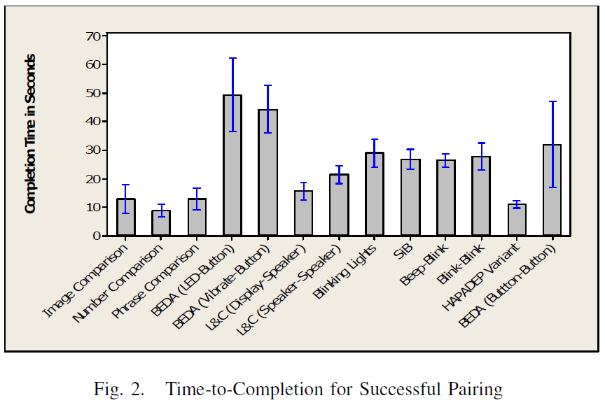
Interpreting Time
Completion time
Fast:
  Number Comparison
  HAPADEP
  Phrase & Image Comparison
  L&C Display-Speaker
Slow:
  L&C Speaker-Speaker
  BEDA LED-Button

Slide 27
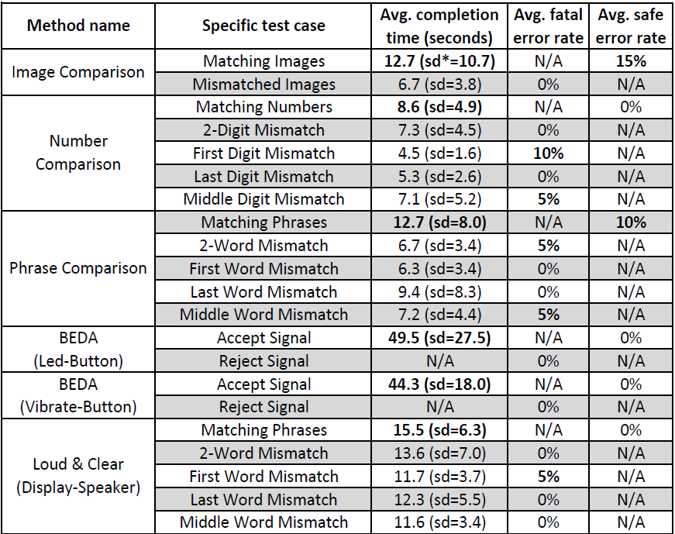
Interpreting Error Results
Error rate 5%:
  such errors are unlikely to occur in practice, under normal circumstances
Error rate 10%↑:
  there might be reasons for concern.

Slide 28
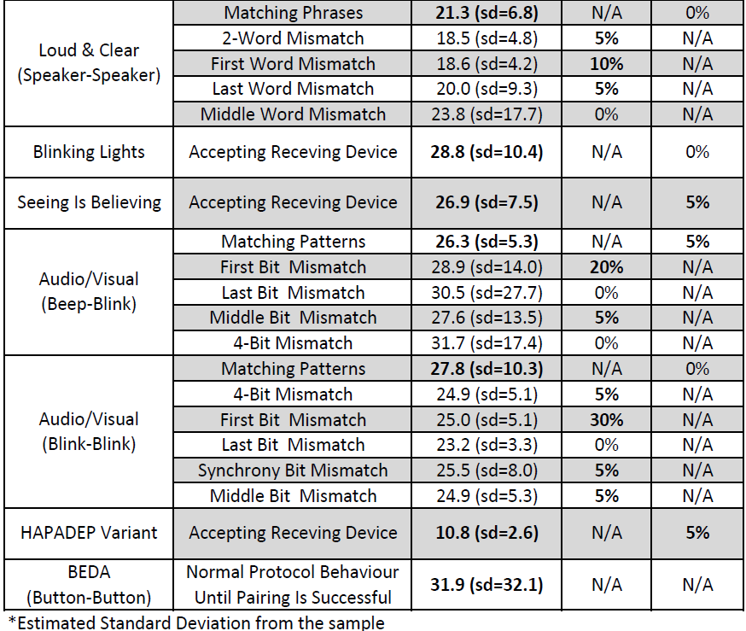
Interpreting Error Results
Avg. fatal error rate:
  False negative(acceptance of a failed pairing instance)
Avg. safe error rate:
  False positives(rejection of a successful pairing instance)
Notes:
使用者大量介入所以出錯機率高

Slide 29
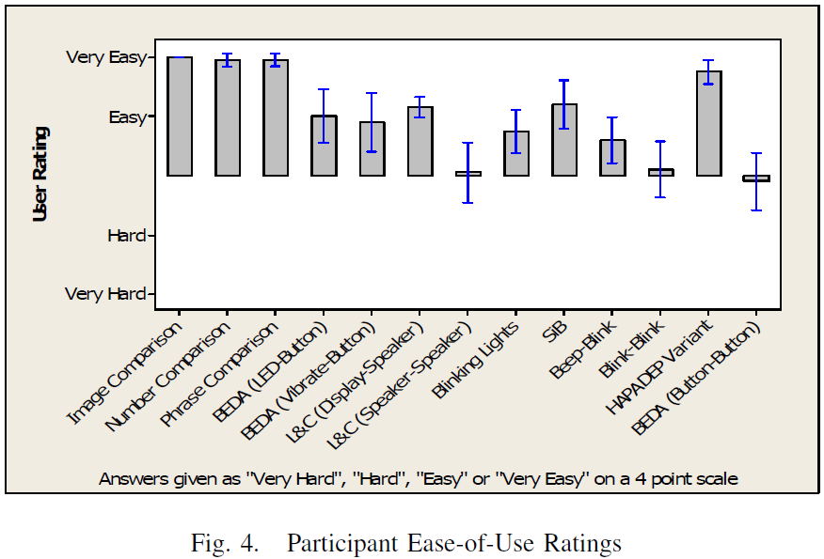
Interpreting Ease-of-Use
Recommended for scenarios with two display-equipped devices.
  Number Comparison
  Image Comparison
  Phrase Comparison

Slide 30
Interpreting Ease-of-Use
At least one device lacks a display but one has a speaker, and the a microphone.
  Audio pairing(HAPADEP)

Slide 31
Interpreting Ease-of-Use
Low ease-of-use ratings:
  Blink-Blink
  L&C Speaker-Speaker
  BEDA Button-Button

Slide 32
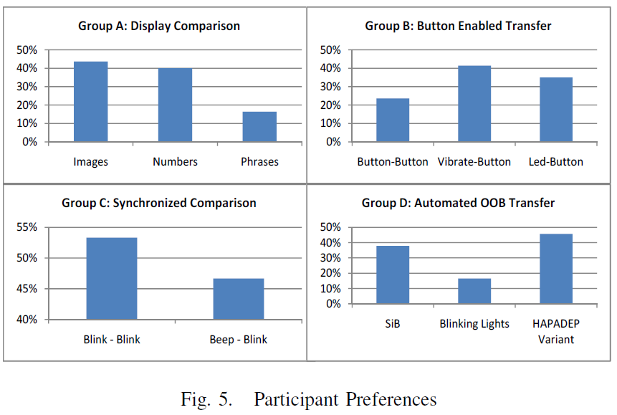
Interpreting User Preference
Group A:
  All comparison-based methods needing displays on both devices.
  The choice between image and number comparison should depend on the display quality.
Notes:
雖然數字比較是最快的，圖像比較實際上是比較好的，
雖然兩者都徘徊在40％左右。短語比較落後約20％，顯然不是很受歡迎。
將這些結果與完成時間，錯誤率相結合，和易用性數據，清楚地表明短語比較不應該使用。

Slide 33
Interpreting User Preference
Group B:
  BEDA variants suitable for scenarios where at least one device is interface-challenged.
  It is not surprising that Vibrate-Button is the preferred choice since it involves less user burden.
Notes:
振動很難被忽視或遺漏，且在震動時按壓按鈕，比同時按下兩個按鈕或對閃爍LED作出反應來的容易。

Slide 34
Interpreting User Preference
Group C:
  Synchronized Beep-Blink and Blink-Blink methods.
  Since these methods are not fast, have relatively high error rates, and are considered hard by users,

Slide 35
Interpreting User Preference
Group D:
  Automated methods that impose light user burden: SiB, Blinking Lights and HAPADEP.

Slide 36
Conclusions and future work

Slide 37
Conclusions
We presented the first experimental evaluation of prominent device pairing methods.
Devices have appropriate-quality displays:
  Visual Number and Image Comparison are quite attractive overall, being both fast and secure as well as acceptable by users.
Devices lacking screens:
  HAPADEP variant seems to be preferable , it is fast, error-free and requires very little user intervention.
Devices lacking screens, speakers and microphones:
  LEDButton or Vibrate-Button.

Slide 38
Future Work
Experiments with more diverse participant pools.
Experiments involving different (more diverse) devices.
Gathering user input about perceived security of methods
Obtaining comprehensive user evaluation for each method.

